Slide 1
Potential Variables Influencing
Special Education Enrollment
Scott Rehn
Kelli Roddy
Amanda Stambaugh
Katie Welter

Slide 2
Special Education Referral Process
Notes:
Slides at end of presentation

Slide 3
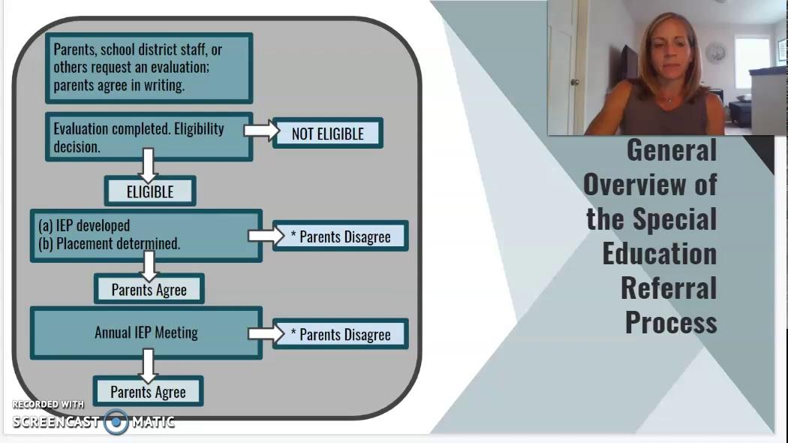

Slide 4
Child Find &
Pre-Referral
Child Find Process
Each school district must develop a system to identify students with disabilities.
The child find system should include the process for receiving referrals from parents, physicians, private and public programs, and health and human services agencies.

Slide 5
Child Find &
Pre-Referral
Child Find Process
Pre-Referral Intervention
Each school district must develop a system to identify students with disabilities.
The child find system should include the process for receiving referrals from parents, physicians, private and public programs, and health and human services agencies.
Before a school district refers a student for a special education evaluation, the district must conduct at least two research-based pre-referral interventions.
Pre-referral interventions can be waived if parents request the evaluation or it is urgent.

Slide 6
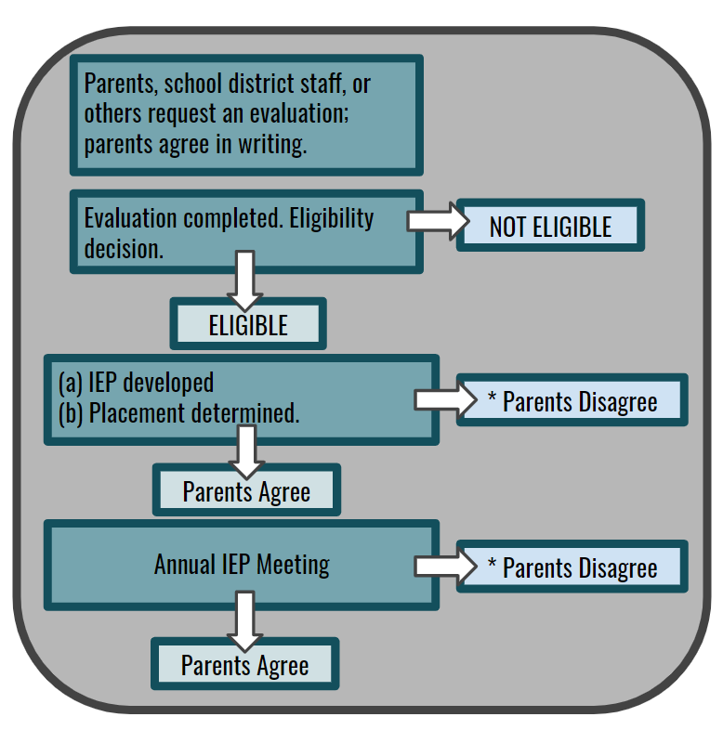
General Overview of the Special Education Referral Process

Slide 7
General Overview of the Special Education Referral Process

Slide 8
General Overview of the Special Education Referral Process

Slide 9
General Overview of the Special Education Referral Process

Slide 10
PACER
Additional Information/
Resources
Minnesota Department of Education
https://www.pacer.org/parent/understanding-the-spec-ed-process.asp#:~:text=It%20shows%20what%20happens%20from,referral%20for%20an%20initial%20evaluation.
https://education.mn.gov/MDE/dse/sped/caqa/IEP/043975

Slide 11
Disproportionality in
Special Education
Disproportionality is defined as the “overrepresentation” and “under-representation” of a particular population or demographic group in special or gifted education programs relative to the presence of this group in the overall student population
(National Association for Bilingual Education, 2002).

Slide 12
Why is this a problem?
Disproportionality in special education may...
Prevent children from reaching their academic potential
Fuel negative stereotypes
Result in lowered expectations among teachers, parents, and the students themselves
Prevent schools from recognizing the need to adjust curriculum and teaching methods to reach a broad range of instructional needs of a diverse student body

Slide 13
1) Do districts with higher poverty rates have higher rates of identified special education students?
2) Does population density correlate with the percentage of identified special education students?
3) Do districts with a higher rate of students of color have a higher rate of identified special education students?
4) Do districts with a higher rate of English language learners have a higher rate of identified special education students?
Research Questions

Slide 14
Data Exploration & Cleanup

Slide 15
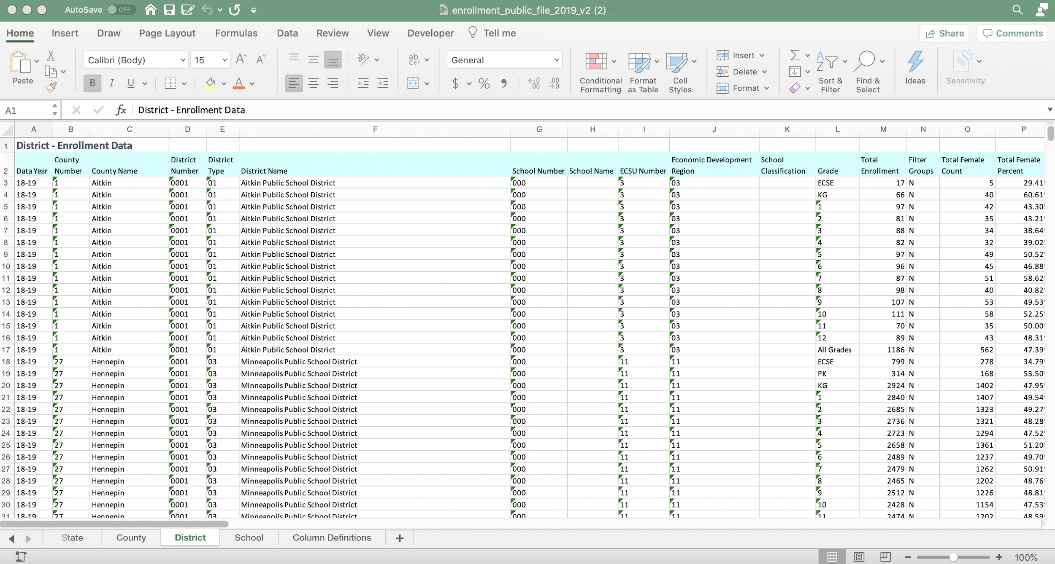
MDE Data
This public data set has 80 columns of information. We used the district subset of data and manually removed unneeded columns and duplicate rows.

Slide 16
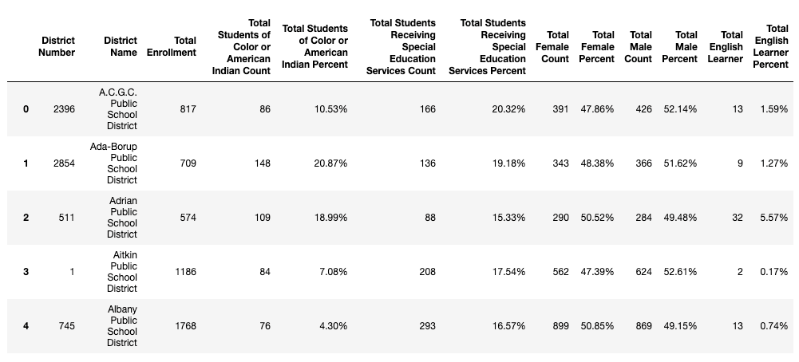
MDE Data
The results were 329 rows x 13 columns

Slide 17
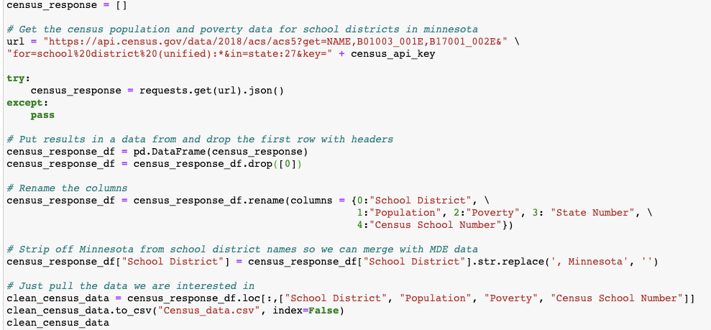
Census Data
We used the American Community Survey: 5-Year Estimates: Detailed Tables
get=NAME,B01003_001E,B17001_002E&for=school%20district%20(unified):*&in=state:27

Slide 18
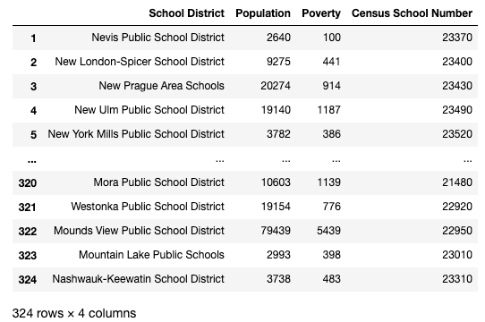
Census Data
The results were 324 rows x 4 columns

Slide 19
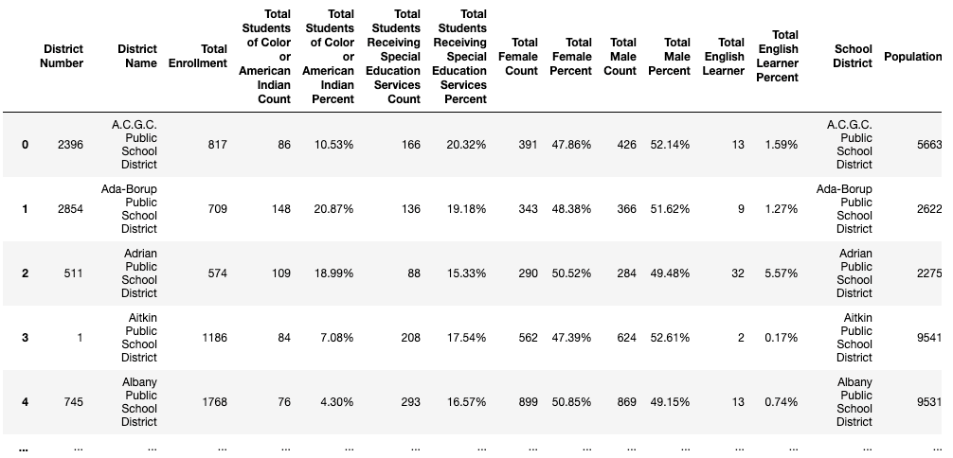
Merged Data
Our final dataset has 320 rows x 17 columns

Slide 20
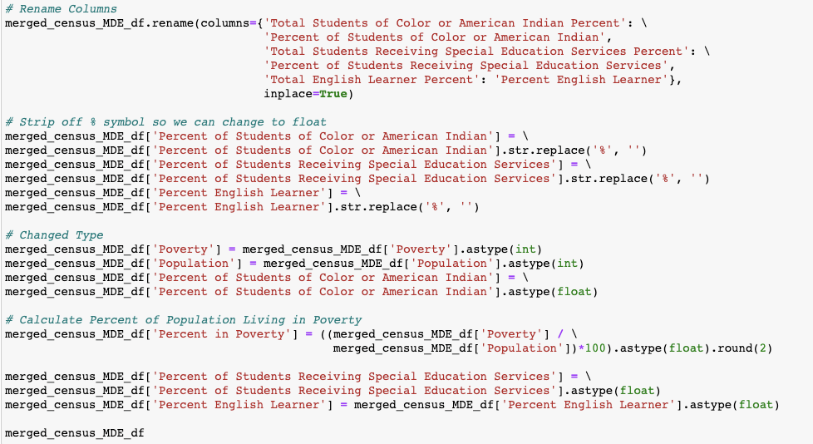
Merged Data
From there we cleaned up our merged data

Slide 21
Data Analysis

Slide 22
Education in the state of Minnesota
Total Students in 2019: 889,304
Students of Color or American Indian : 34.30%
Identified English Language Learners: 8.36%
Identified Special Education Students: 16.18%

Slide 23
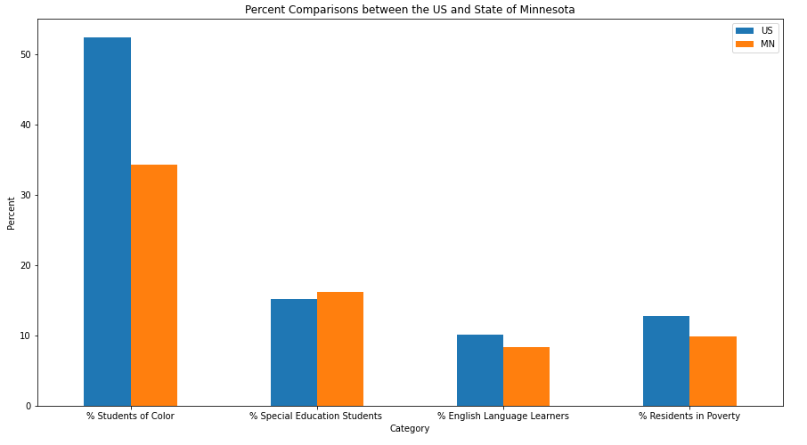

Slide 24
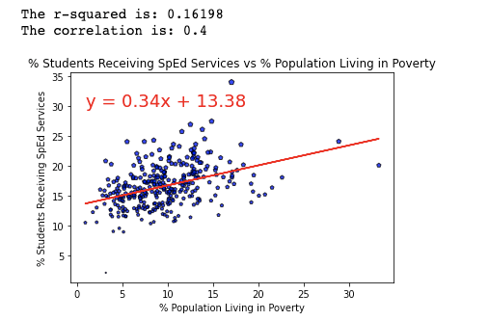
Do districts with higher poverty rates have higher rates of identified special education students?

Slide 25
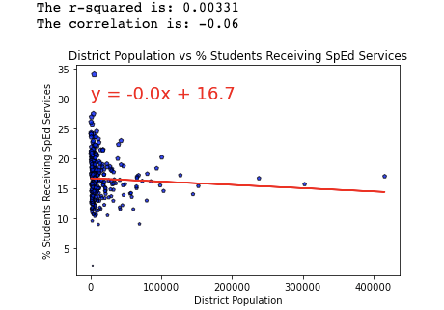
Does population density correlate with the percentage of identified special education students?

Slide 26
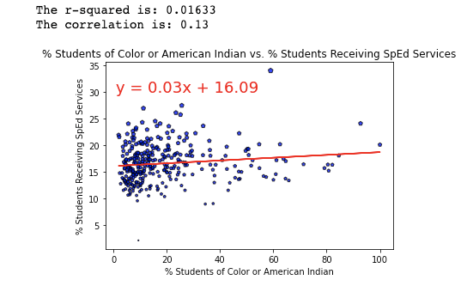
Do districts with a higher rate of students of color have a higher rate of identified special education students?

Slide 27
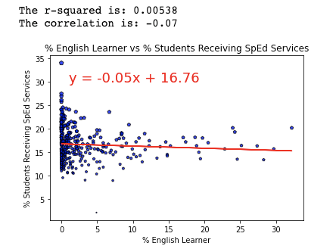
Do districts with a higher rate of English language learners have a higher rate of identified special education students?

Slide 28
Discussion and Post Mortem

Slide 29
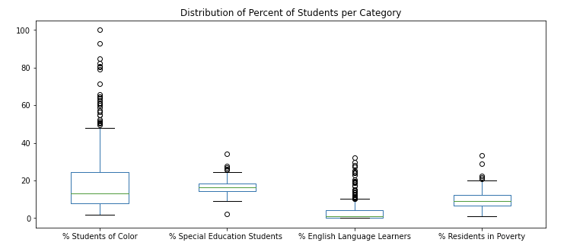
Box Plot

Slide 30
Why Not?
Source of poverty information - pulled from general population, which may not accurately reflect the student population.
Better information may come from comparing the demographics of the overall student population with the demographics of a district’s special education students. (We did not have this data available).
Look at a similar analysis for other states; see if the state of Minnesota is atypical.
Look more closely at outliers

Slide 31
Next Steps/ Future Research
Analyze demographic data of special education students relative to the overall student population in Minnesota
What groups are disproportionately represented in special education in Minnesota
Further evaluate potential variables influencing special education referrals in individual school districts
Dive deeper into some of our more extreme outliers

Slide 32
Data Sources &
References
Individualized Education Program (IEP), Evaluations and Eligibility. (n.d.). Minnesota Department of Education. Retrieved July 30, 2020, from https://education.mn.gov/MDE/dse/sped/caqa/IEP/043975
MN % of Special Ed, % Students of Color, % ELL Students - Minnesota Department of Education - Child Count Report (2019)
MN % Residents in Poverty, District Populations - United States Census Bureau - American Community Survey 5-Year Data (2009 - 2018)
Understanding the Special Education Process. (n.d.). PACER Center. Retrieved July 30, 2020, from https://www.pacer.org/parent/understanding-the-spec-ed-process.asp#:%7E:text=It%20shows%20what%20happens%20from,referral%20for%20an%20initial%20evaluation.
U.S. % of Special Ed - National Center for Education Statistics; Digest of Education Statistics; Table 204.70 (2017-18)
U.S. % Students of Color - National Center for Education Statistics; Digest of Education Statistics; Table 203.70 (2017)
U.S. % ELL Students - National Center for Education Statistics; Digest of Education Statistics; Table 204.20 (2017)
U.S. % Residents in Poverty - National Center for Education Statistics; Digest of Education Statistics; Table 102.4 (2018)
Very Well Family. (n.d.). Has Your Child Been Selected for Special Ed Because of Race? Retrieved October 9, 2018, from https://www.verywellfamily.com/disproportionality-in-special-education-programs-2162684#:%7E:text=Why%20Is%20Disproportionality%20a%20Problem,may%20have%20been%20incorrectly%20identified.

Slide 33
Questions?

